Slide 1

College Name – Lamrin Tech Skills University Punjab Course Name – Dsign Thinking & Critical Thinking Branch – Btech ( Electrical Engineering ) Batch No – 2024 Presented By – Sudhir Bhardwaj Roll No – 24100130006 Task No #10 – Article for any one of the given problem Title - AI in Healthcare: Improving Diagnosis and Treatment

Slide 2
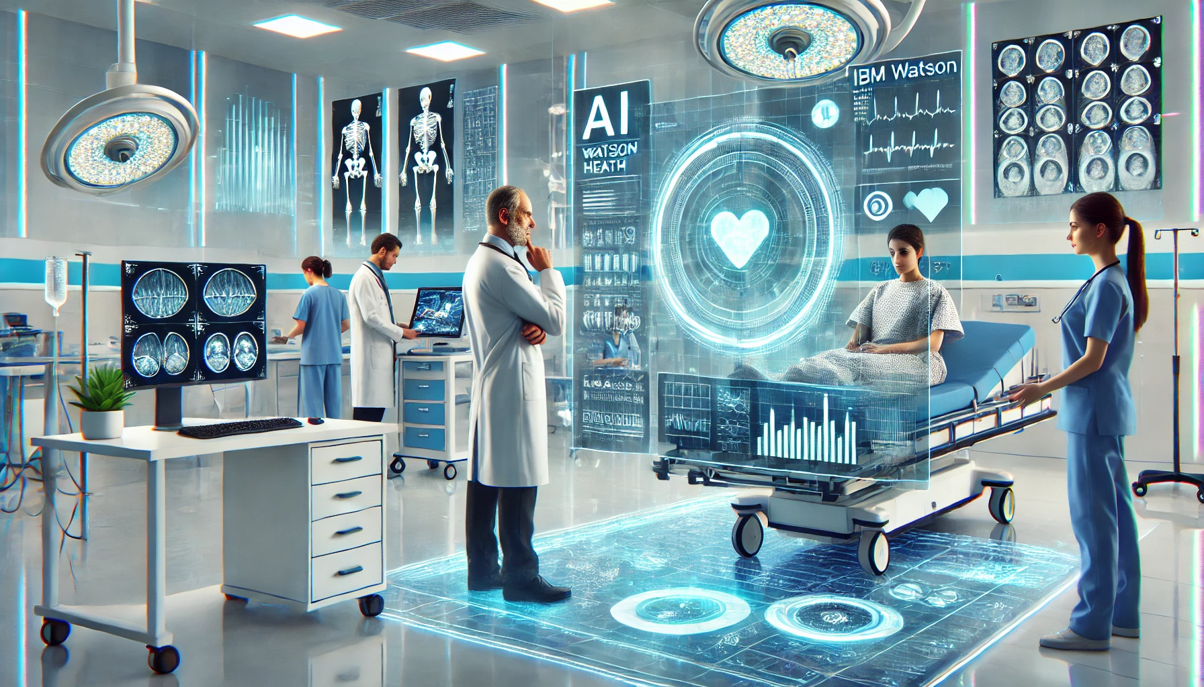
. Reference Article: The article could discuss how artificial intelligence (AI) is used in healthcare to assist doctors in diagnosing diseases, predicting outcomes, and providing personalized treatments. For instance, AI-powered systems like IBM Watson Health or Google DeepMind demonstrate how machine learning is applied in real-world healthcare scenarios

Slide 3
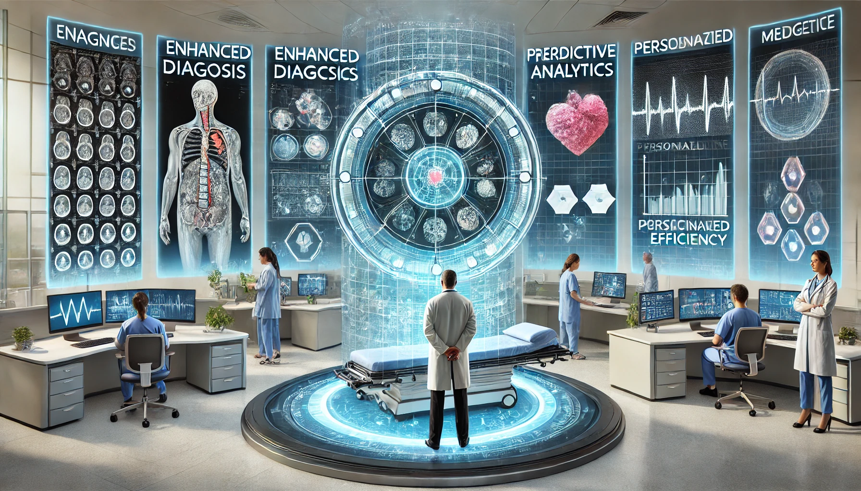
Key Insights from the Article: Enhanced Diagnosis: AI algorithms can process large datasets of medical images to detect abnormalities with high accuracy. For example, AI-based tools can identify early signs of cancer in radiology scans faster than traditional methods. Predictive Analytics: AI predicts patient outcomes by analyzing historical and real-time data. This capability enables doctors to implement preventive measures or optimize treatment plans. Personalized Medicine: AI supports tailoring treatment plans specific to a patient’s genetic makeup, medical history, and lifestyle factors. Operational Efficiency: AI optimizes hospital operations, such as scheduling surgeries, managing inventory, and allocating resources, leading to better efficiency and cost savings.

Slide 4
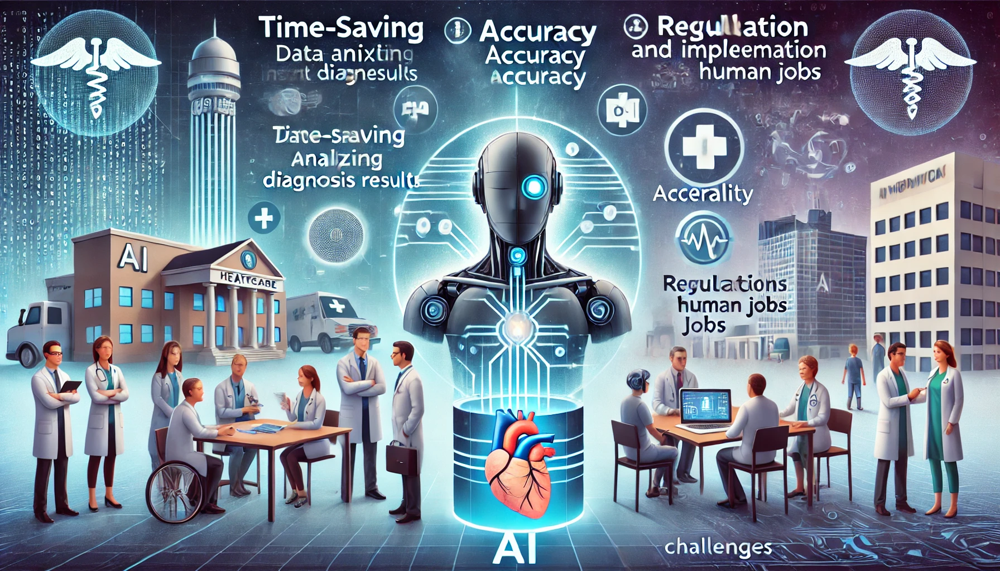
Advantages Discussed: Time-Saving: AI significantly reduces the time required for diagnosis and decision-making. Accuracy: High precision in diagnosing diseases like cancer, diabetes, or heart conditions. Accessibility: AI tools provide solutions in remote areas where specialists may not be available. Ethical and Implementation Challenges: The article also highlights challenges like data privacy, the need for regulation, and the potential for AI to replace human jobs. Addressing these concerns requires careful planning and collaboration between technologists, policymakers, and medical professionals.

Slide 5
Personal Inference: The use of AI in healthcare is a promising step toward solving some of the most persistent problems in the medical field. While challenges exist, the benefits far outweigh the risks when implemented responsibly. The integration of AI can save lives, reduce healthcare costs, and make quality medical services accessible to all.

